Slide 1
Microservices 1

Slide 2
Service registration and discovery
Configuration Server
Circuit Breaker
Logging
Caching

Slide 3
Service registration and discovery

Slide 4
Service registration
To allow a client to call a service it must find an endpoint.
The Service Registry allows service providers to register their endpoints under a common service name
To allow clients to retrieve a list of endpoints for a common service name.
The Service Registry is being used by Service Discovery Patterns.
Notes:
The best known Service Registry is the Domain Name System (DNS).

Slide 5
Service registration illustration
When going up / down
Microservice
Service Registry
Microservice
When going up / down

Slide 6
Service discovery
The client queries a service registry to which all service instances register themselves.
The client then uses some sort of load balancing mechanism to select one of the available service instances and sends his request.
The client is responsible for determining the network locations of available service instances and load balancing requests across them.

Slide 7
Service discovery illustration
1
Service Registry
Client
2
3
Microservice

Slide 8
Discovery characteristics
Counterpart to registration from the point of view of clients
Service instances have dynamically assigned network locations. Moreover, the set of service instances changes dynamically because of autoscaling, failures, and upgrades
Client queries the service registry and routes each request to an available service instance

Slide 9
Exercise to register / discover service

Slide 10
Configuration Server

Slide 11
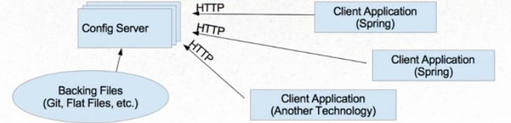
Why we use configuration server
used to prevent hard-coding values in the applications
if we change a property for a microservice, it can reflect that on the fly without redeploying the microservice
if the environment changes, we need to pick right properties file.
e.g. for development, we need to load the development property file

Slide 12
Circuit Breaker

Slide 13
Why we use circuit breaker
when one service synchronously invokes another there is possibility that the other service is unavailable (or high latency)
previous resources might be consumed in the caller while waiting for the other service to respond
might lead to resource exhaustion, which would make the calling service unable to handle other requests
the failure of one service can potentially cascade to other services throughout the application

Slide 14
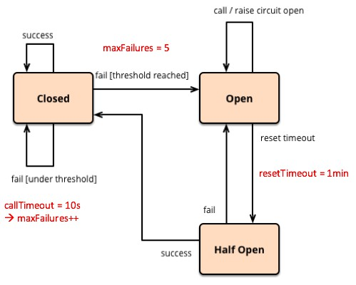
How circuit breaker works?
when the number of consecutive failures crosses a threshold, the circuit breaker triggers
the duration of a timeout period, all attempts to invoke the remote service will fail immediately
after the timeout expires, the circuit breaker allows a limited number of test requests to pass through
if those requests succeed, the circuit breaker resumes normal operation
otherwise, if there is a failure the timeout period begins again

Slide 15
Logging

Slide 16
Logging issue in microservices
Problem
How to understand the behavior of an application?
How to troubleshoot problems?
Solution
Use a centralized logging service that aggregates logs from service instances.
Can search and analyze the logs.
Can configure alerts when certain messages appear in the logs.

Slide 17
Log management considerations - 1
Log Shipper
Collect raw logs from different servers
Log Parser
Unstructured log messages must be parsed to structure logs at least into timestamp, severity and message field.
Log Storage
The log storage must be scalable to deal with high event frequency during peak hours and always growing log volume.
Data is typically kept for a limited time.
In many cases, keeps an index for fast log search.

Slide 18
Log management considerations - 2
Log Search
The idea of centralized log management is to have the capability to search for logs in one central place.
Log Visualization
help to visualize log statistics
e.g. to show a timeline of error events or the total amount of logs over time.
Charts could be created for any information provided in structured logs
e.g. visualization of web server logs can tell you a lot about user behavior.
Log Alerting
important to get notified in real-time when the log management system detects any suspicious log behavior.

Slide 19
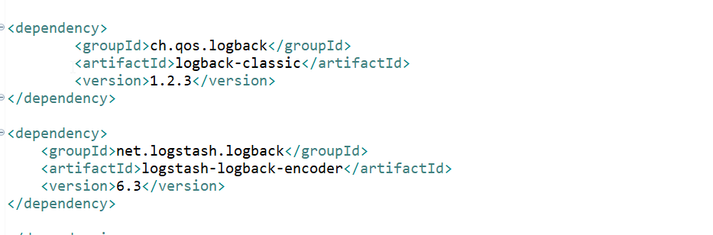
Configurations in Spring Boot
pom.xml
In maven pom file, add two dependencies in it. logback-classic and logstash-logback-encoder
Logback-classic work as the underlying logging framework. Maven will help to pull slf4j-api and the abstract API on the logging framework
Logstash-logback-encoder help us transform the logging message into a json format which is understandable by the logstash

Slide 20
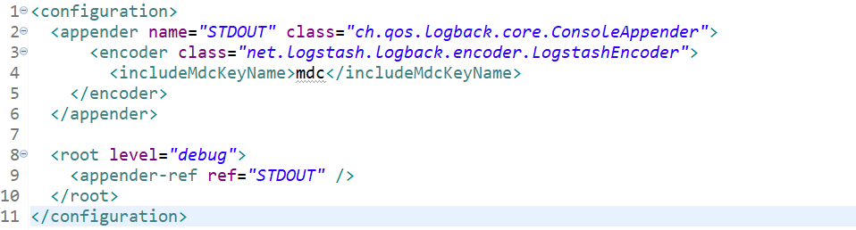
Configurations in Spring Boot
logback.xml
Define a new file logback.xml in your classpath, e.g. under resources folder (…/src/main/resources):

Slide 21
Configurations in Spring Boot
log the message
Define the logger in your class:
private static final Logger logger = LoggerFactory.getLogger(OrdersApiDelegateImpl.class);
Log your message:
logger.info(“This is a testing line”);
An example in the log file:
{"@timestamp":"2020-03-30T18:58:25.692+08:00","@version":"1","message":"request: GET http://localhost:8100/v1/inventories/1","logger_name":"com.exercise.orders.api.impl.OrdersApiDelegateImpl","thread_name":"http-nio-8200-exec-2","level":"INFO","level_value":20000,"httpStatus":"200"}
Notes:
The log is in JSON format

Slide 22
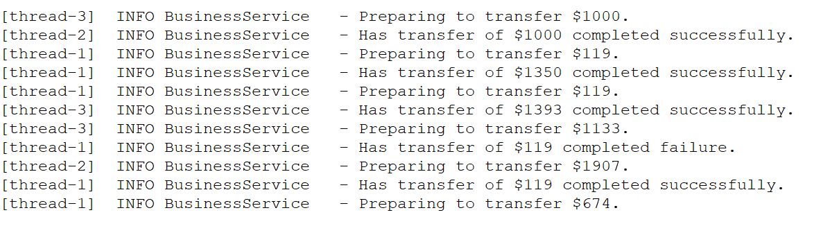
API logging messages challenges
We have a business microservice which have money transfer feature. Here are the log entries
It’s impossible to distinguish between two different transactions of the same amount executed by the same thread because the related log lines look substantially the same and provided the input value is same also. e.g Same account, sample people perform the transfer two times

Slide 23
Why MDC
Mapped Diagnostic Context (MDC). MDC allows us to fill a map-like structure with pieces of information that are accessible to the appender when the log message is actually written.
To uniquely stamp each request, we may put contextual information into the MDC, the abbreviation of Mapped Diagnostic Context.
Example:
MDC.put(“transactionId", “123456”);
log.info(“Log message”);
MDC.clear();
Log:
{"@timestamp":"2020-03-30T18:58:25.692+08:00","@version":"1","message":"request: GET http://localhost:8100/v1/inventories/1","logger_name":"com.exercise.orders.api.impl.OrdersApiDelegateImpl","thread_name":"http-nio-8200-exec-2","level":"INFO","level_value":20000,“transactionId":“123"}
Add a new field to the log
A new field added

Slide 24
Why MDC
The MDC structure is internally attached to the executing thread in the same way a ThreadLocal variable would be.
And so, the high level idea is:
to fill the MDC with pieces of information that we want to make available to the log appender
then log a message (can log multiple times in different places)
and finally, clear the MDC

Slide 25
Elastic Stack (formerly known as ELK Stack)
The Elastic Stack contains most of the tools for a log management solution:
Log shippers such as Logstash and Beats
Elasticsearch as a scalable search engine
Kibana as UI to search for logs or visualizations
Alerting for logs (only available under the commercial Elastic license)
Security (partially free to use, however under Elastic license)

Slide 26
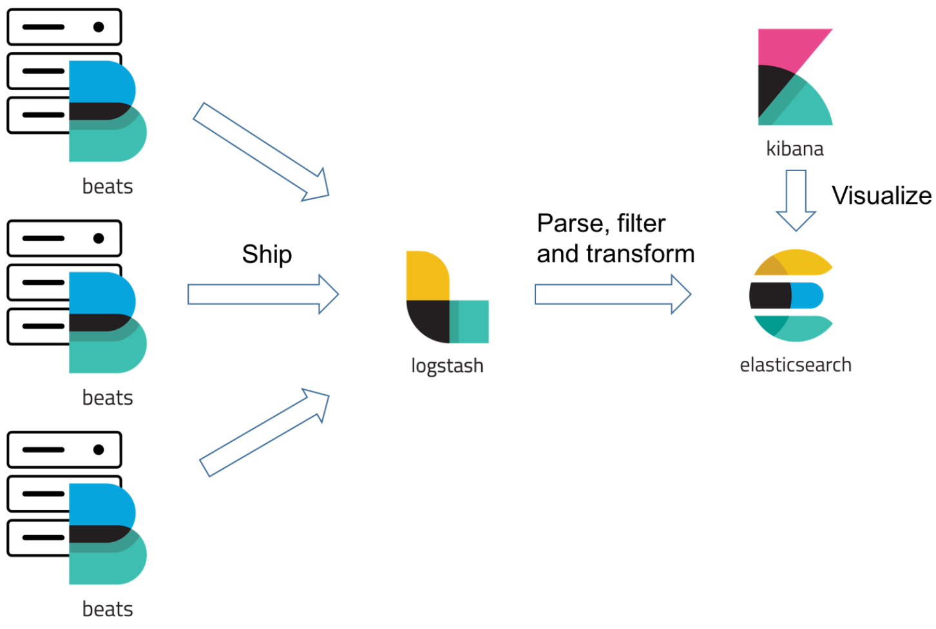
Elastic Stack illustration

Slide 27
Caching

Slide 28
Why caching in Microservices
Respond to the user very fast – performance
Respond database cost – performance
Increase Read Throughput (offer higher request rates) – performance
Respond to a lot of users – scalability
Decrease downtime – fault tolerance

Slide 29
Considerations
What to cache
Objects and configurations are the most common things
When to cache
Caching can be performed one-time during application startup, or also an on-demand basis
Where to cache
In-memory and distributed caching are the 2 most common places
How long to cache
The freshness of the data is important.
Choose your cache refresh mechanism carefully: Periodic and Workflow
Notes:
Objects are the business entities our applications are constantly operating on.
Configurations are the application wide settings like images and static global values. Periodic – schedule to refresh at a certain time, this is simple and when time is not a critical factor.
Workflow - to bust cache based on the business workflow, e.g. as soon as a merchant updates the prices of products we can bust the cache

Slide 30
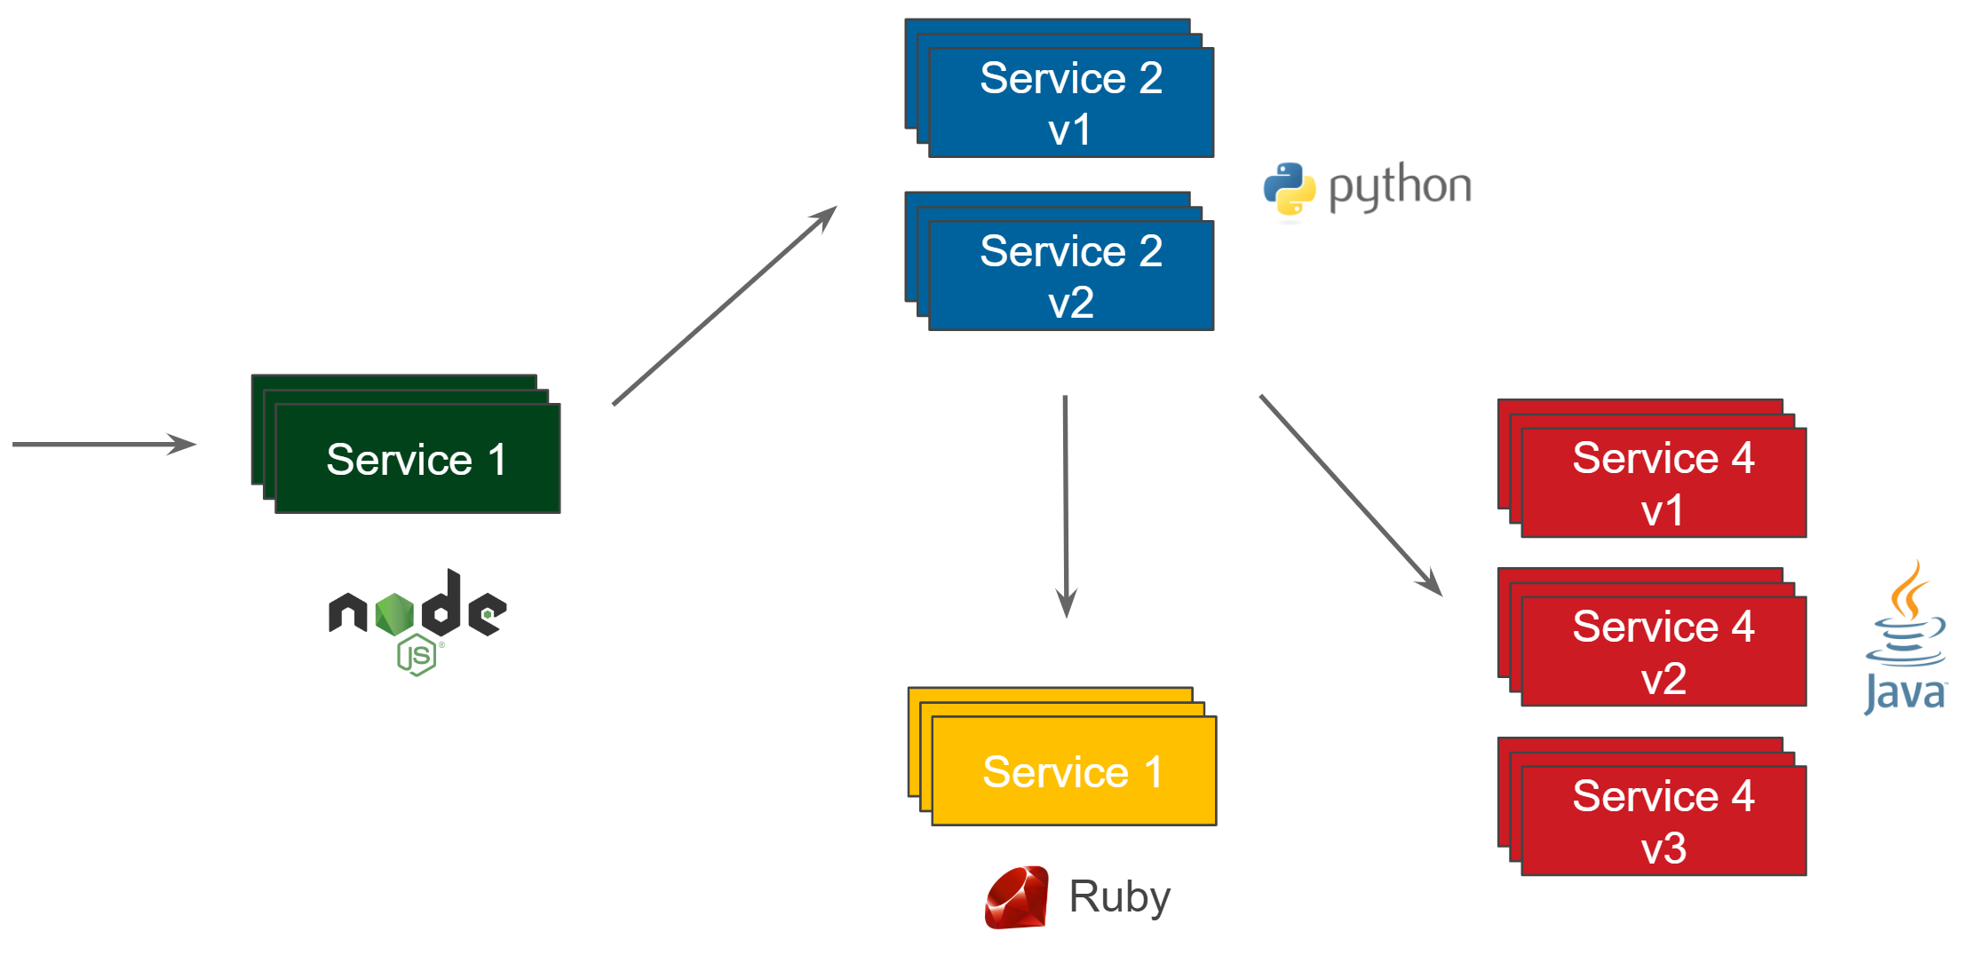
Question – where do you put the cache?
Notes:
Caching is everywhere. However, in which part of your system should it be placed?
If you look at the following diagram representing a simple microservice architecture, where would you draw the “cache” rectangle for your microservice cache strategy?

Slide 31
Caching
Caching Architectural Patterns

Slide 32
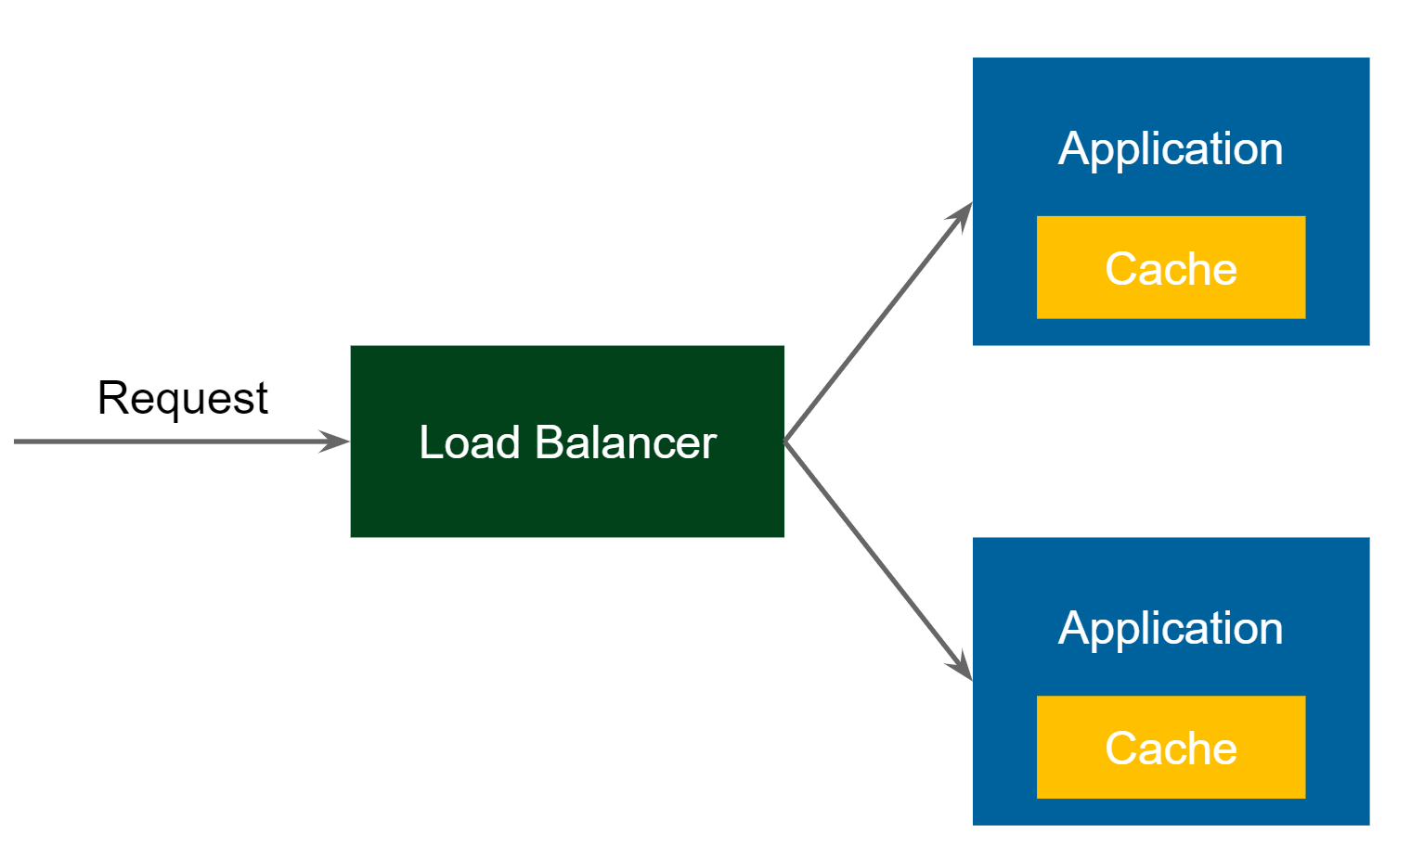
Pattern 1 - Embedded Cache
Request comes in to the Load Balancer
Load Balancer forwards the request to one of the Application services
Application receives the request and checks if the same request was already executed (and stored in cache)
If yes, then return the cached value
If not, then perform the long-lasting business operation, store the result in the cache, and return the result

Slide 33
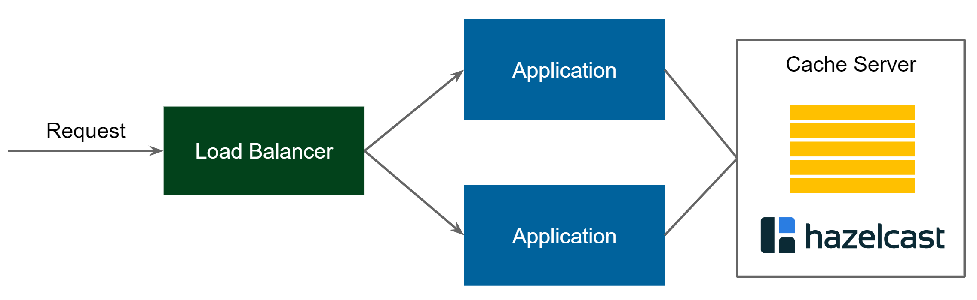
Pattern 2 - Client-Server Cache
Request comes into the Load Balancer and is forwarded to one of the Application services
Application uses cache client to connect to Cache Server
If there is no value found, then perform the usual business logic, cache the value, and return the response
Notes:
This architecture looks similar to the classic database architecture. We have a central server (or more precisely a cluster of servers) and applications connect to that server.

Slide 34
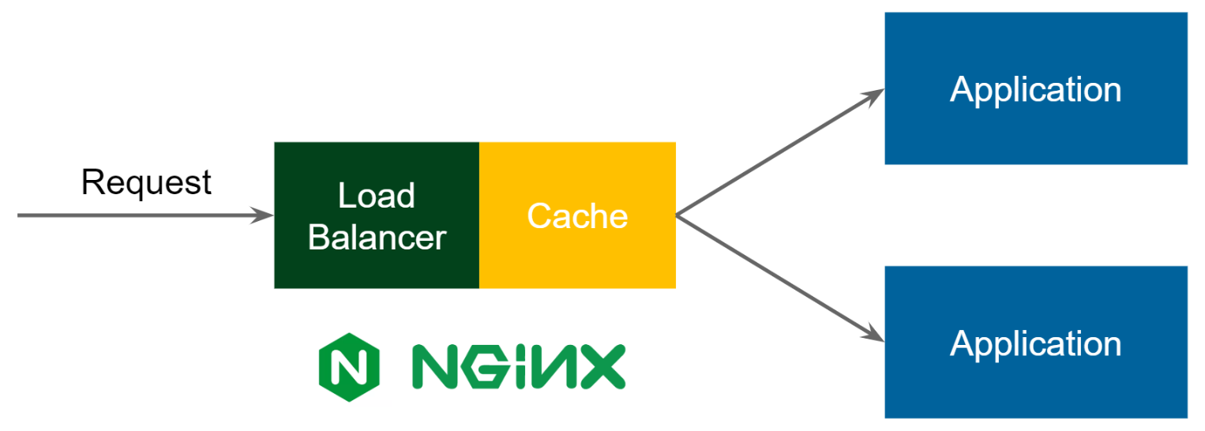
Pattern 3 - Reverse Proxy Cache
Request comes in to the Load Balancer
Load Balancer checks if such a request is already cached
If yes, then the response is sent back and the Request is not forwarded to the Application
Notes:
Such a caching solution is based on the protocol level, so in most cases, it’s based on HTTP, which has some good and bad implications:
The good thing is that you can specify the caching layer as a configuration, so you don’t need to change any code in your application.
The bad thing is that you cannot use any application-based code to invalidate the cache, so the invalidation must be based on timeouts.
NGINX provides a mature reverse proxy caching solution; however, data kept in its cache is not distributed, not highly available, and the data is stored on disk.

Slide 35
Pros & Cons
 | Pros | Cons
Embedded Cache | Simple configuration and deployment Low-latency data access | Not flexible management (scaling, backup) Data collocated with applications
Client-Server Cache | Data separate from applications Separate management (scaling, backup) | Separate Ops effort Higher latency
Reverse Proxy Cache | Configuration-based (no need to change applications) Programming-language agnostic | Difficult cache invalidation No mature solutions yet Protocol-based (e.g., works only with HTTP)
Notes:
Language agnostic refers to aspects of programming that are independent of any specific programming language.

Slide 36
Exercises
Build service-to-service api
Create an Orders service
Develop Orders service by making a request to the Inventories service
Develop business logic while getting the response from another service
Log the messages for the services
Protect the API services using JWT token

Slide 37
Summary
What is covered
Service registration and discovery
Configuration Server
Circuit Breaker
Logging
Caching

